Slide 1
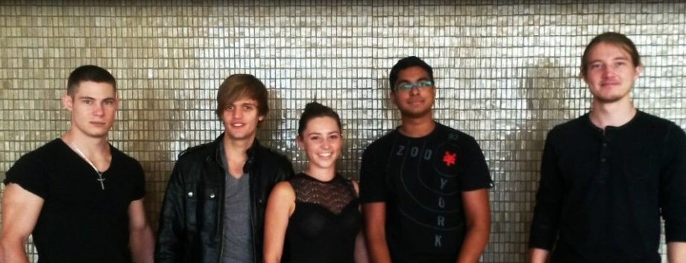
Team Eclectic
Project Linphone-Waterfall

Slide 2


The Client
The Client 2.0
Kobus Coetzee

Slide 3

Work Division
David – Database & Interfaces
Izak – Android Classes
Jessica – UI Design
Paul – Core & Interfaces
Prenolan – Encryption & Interfaces

Slide 4

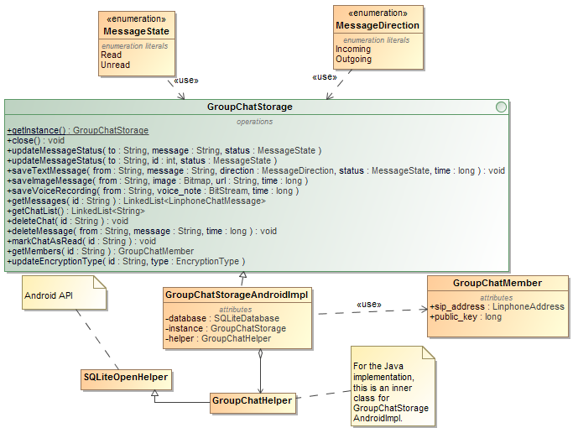
Data Storage
GroupChatStorage Interface
Getters and Setters

Slide 5
Core
LinphoneGroupChatListener
LinphoneGroupChatManager
LinphoneGroupChatRoom
Group Communication (Invites, removals, etc.)
Type of message identified through message headers,
Admin is the “centre” of the system

Slide 6
Encryption
AES256 (Asymmetric vs. Symmetric)
Key Exchange (DH vs. RSA)
SHA256

Slide 7
User Interface
LinphoneActivity
ChatListFragment
GroupChatSettingsFragment
GroupChatMessagingFragment
GroupChatActivity
GroupChatCreationFragment

Slide 8
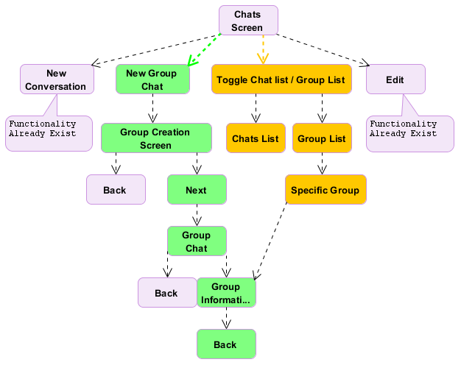
User Interface
Design
Layout
Flow
Consistency

Slide 9

Timeline
SRS
PSAC
SDD
Coding
Testing & ATP
Final Documentation
Completed 30th May
Completed 27th June
Completed 22nd July
Current Phase
End of September
End of September (after product finalization)

Slide 10

Goals
Finish coding in the first half of September
Integrate and test in the second half
Early October: finish off documentation

Slide 11

Thank You

